Slide 1
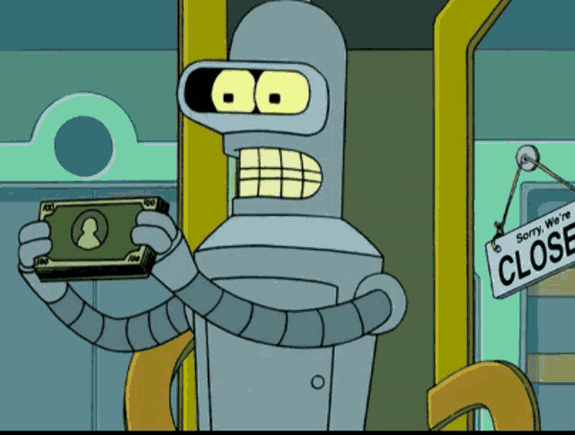
Social Preferences toward AI: Are people willing to share earnings with AI?
- Buğra Oğuz
Futurama (1999 -)

Slide 2
OUTLINE
Summary
Motivations
Literature Review
Design
Hypothesis
By the Results...

Slide 3
SUMMARY
*This experiment aims to test people’s social preferences toward AI.
The experiment is composed of two parts: Production and Distribution.
At production part human players randomly team with either other humans or with AI. Participants are not aware of their teammate’s identity.
They independently solve puzzles but their earnings are stacked within the group.
After production part, humans answer a questionaire about other player’s contribution.
Distribution happens through a dictator game.

Slide 4
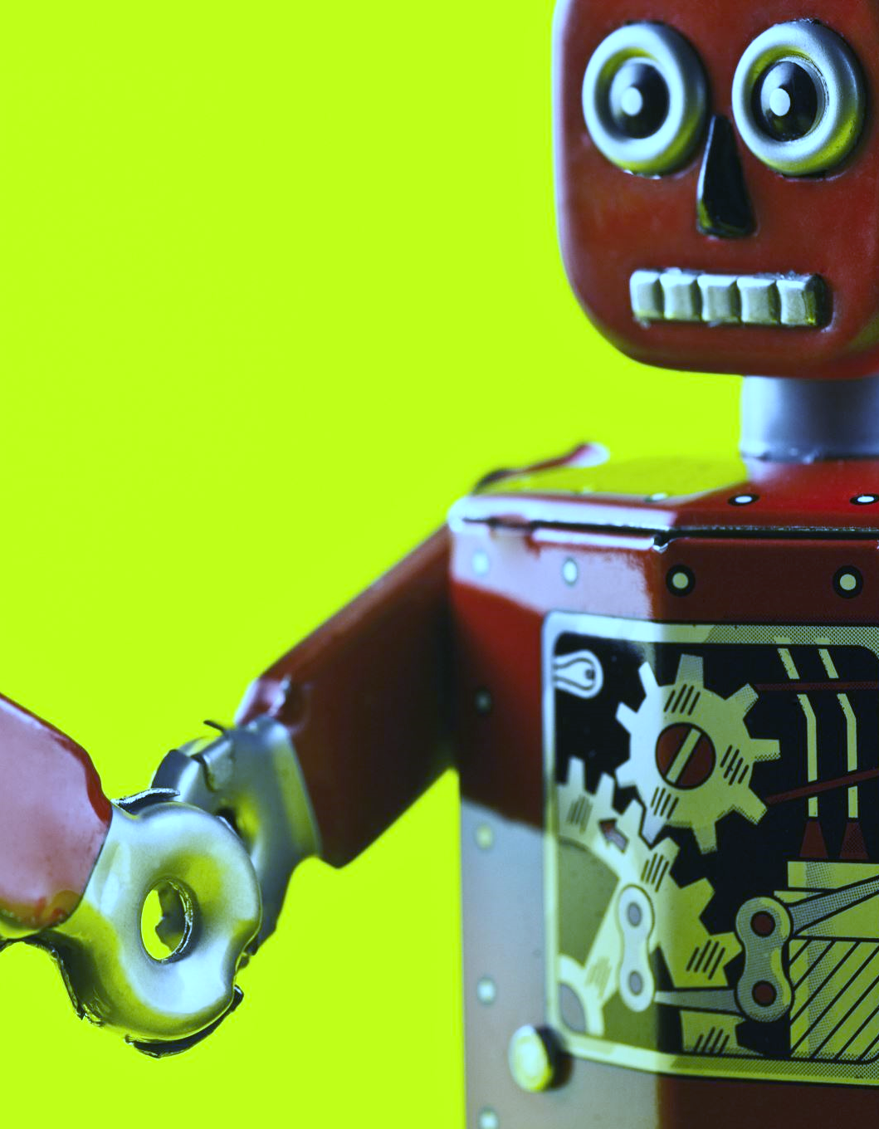

MOTIVATIONS
Motivations were to understand the followings:
How humans view AI’s role on the production?
How much value do humans assign to AI contributions?
How much humans share with AI?
Whether sharings change with different productivity levels?
Whether sharings change with partner identity?

Slide 5
LITERATURE REVIEW (1/2)
Charness et al. (2023b) & Damioli et al. (2021) -> AI increase productivity.
Dafoe et al. (2021) -> Co-op AI can solve complex problems in real life.
March (2019) -> No research with CP as an agent in production.
Noy and Zhang (2023) -> AI as a complementary tool increased productivity.
Von Schenk et al. (2023) -> Machine payoffs differ. More sharing toward robots when there is a human behind, but always sharing toward robots.

Slide 6
LITERATURE REVIEW (2/2)
Nielsen (2021) & Nass (1994) -> Computers are social actors. Humans act prosocially, apply social categories and have emotions toward robots.
Gonzalez et al. (2022) & Fraune et al. (2021) -> In-group humans >in-group robots > out-group humans > out-group robots (groups of 2x2 robot-human)
Makovi et al. (2023) -> Humans believe robots could desire money.
Balogun et al. (2024) & Cremer (2007) -> AI can solve puzzles effectively.
Immorlica (2024) -> AI should be implemented as an agent to understand their impact on strategic behavior

Slide 7

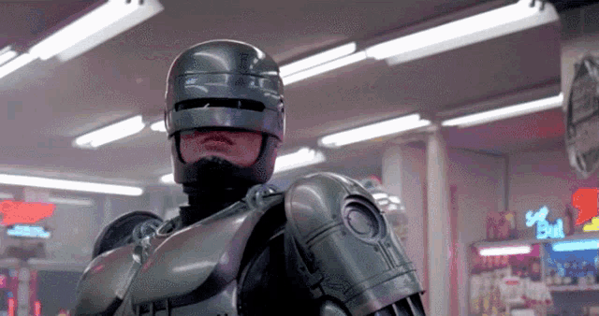
DESIGN (1/3) Production Phase:
Teams randomly form as a human-human or human-AI.
Players dont know about other player’s identity.
Each player solves 6 puzzles. Each solved puzzle contributes to the group earnings. Every players have limited time to solve the puzzle and cannot move on to the next puzzle until current puzzle is solved. After solving a puzzle players are asked about difficulty of the puzzle. Puzzles are designed to get harder at each stage.
Puzzles are assigned randomly from a pool of puzzles. There are 6 categories of puzzles according to difficulty and each player randomly get an appropriate puzzle for each category.
Robocop (1987)
Notes:
First * is a treatment.
Puzzle difficulty will be evalueated by organizing puzzle solving sessions, independent of this experiment. The success rate of he puzzles will be evaluated by human participant performances on those puzzles.

Slide 8
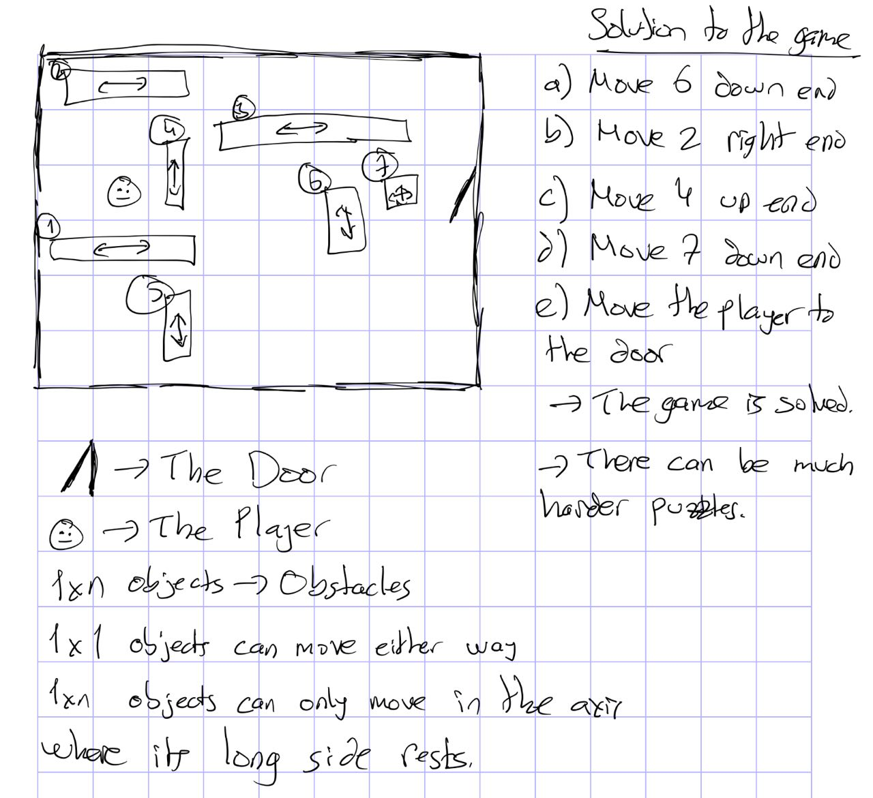
Alternative Depictions of the Game
DESIGN (2/3)
*The puzzles in the images are not the same puzzle.

Slide 9


DESIGN (3/3) Questionaire and Distribution Phase:
Players will be given info about their teams performance.
Half the participants will be given info about their teammates identity (whether human or AI).
All the participants will be asked «how much do you think your teammate contributed to total earnings in percentages (?/100)
After the questionaire, at the distribution part all participants will be given info about their teammates identity. A dictator will be chosen randomly. And the distribution will be made.
Blade Runner (1982)
Notes:
Second * is a treatment

Slide 10
HYPOTHESIS
AI performance could be better than humans. Moreover, this difference could increase at harder tasks. This can be due to AI performing better at well-structered complex games as Ren et al. (2023) shows.
Relative share could be higher at human-human side as humans favor humans but absolute share could be higher at human-AI side as AI is expected to outperform humans.
Questionaire answers and distribition decisions will be consisent for the informed participants, however for the uninformed distribution could differ from answers in the benefit of humans
Notes:
Humans might have biases. AI could adhere better to algorithm rules.
Von Schenk et al. (2023) shows humans are more willing to share with humans. But Makovi et al. (2023) shows humans share with robots either if they are programmed that way.

Slide 11

By the Results...
We can test how good AI performs, and how much productivity increases it allows.
We can test effect of differing difficulties in puzzles.
We can test sharing differences between AI teammate and human teammate.
We can test value judgements and if shares differ from value judgements especially when other player appears to be AI.
Futurama (1999 -)

